Slide 1
Database Security

Slide 2
Theory/SQL
this presentation gives an overview of the DB security theory
all supporting SQL is in the book, please look it over
we will not be doing any of the practical in class

Slide 3
Login vs. User
Login
server level object
has a password
can have multiple users associated with it
can manipulate server settings but not individual databases
User
database level object
has roles and permissions on objects in a single database

Slide 4
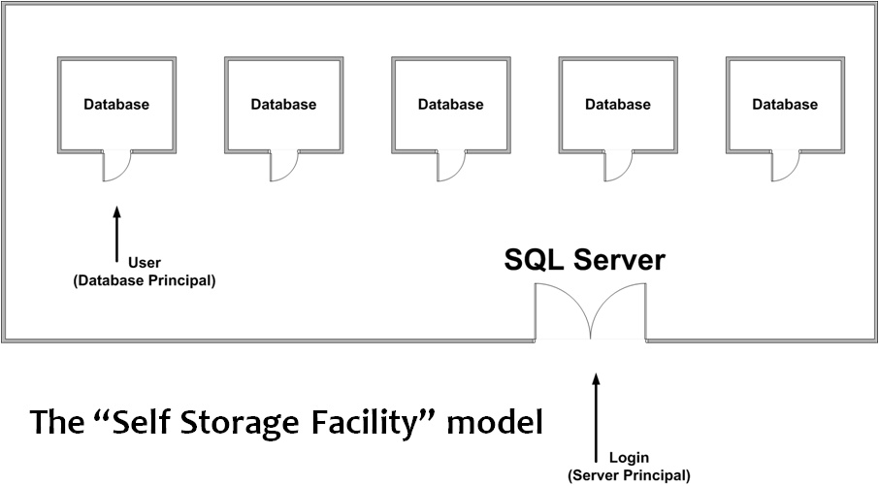
Login vs. User

Slide 5
Access
when an object is created, the creator owns the object (full permissions)
by default nobody else has access to the object
attempting to access an object you lack permissions for results in the system stating the object doesn’t exist

Slide 6
Permissions
you can grant permissions to allow others to access the new object
CREATE/ALTER/DROP database objects
SELECT/UPDATE/DELETE data
EXECUTE stored procedures
permissions can be granted to an individual object or a collection of objects
for example to a single table (Users), or to all views

Slide 7
Permission Stacking
a user can have 3 possible permission states in regards to the ability to access an object
no permission – denies access by default (no permission or permission was revoked)
permission was granted – allows access to the object
permission was denied – denies access to the object
the deny trumps grant, so if a user has both, they are not allowed access
for example I can have a grant to all tables, but deny on a specific table
in this case I will not be able to access the table to which I’m denied access to

Slide 8
Roles
you can grant/deny/revoke specific permissions to specific users
this can be tedious with a large number of users and or objects
to make this easier, we can use roles
you assign permissions to roles
you assign users to roles, this grants the user the role’s permissions
for example – an admin role can have a set of permissions
giving a user this role will give them all of the permissions that the role has; removing the user from the role removes the permissions
roles can be predefined as well as user defined

Slide 9
Server Roles
there’s a number of predefined server roles that you can grant to a login:
public – object in this role is accessible to all users
sysadmin – can perform any activity on the server
securityadmin – used to change logins, server and database roles as well as perform password resets
serveradmin – can change server wide configs and shutdown the server
setupadmin – can add/remove linked servers
processadmin – can end processes on the server
diskadmin – used to manage disk files
dbcreator – create/alter/drop/restore databases
bulkadmin – can run bulk insert statements

Slide 10
Database Roles
there’s a number of predefined database roles that you can grant to a user:
db_owner – all permissions for the DB
db_accessadmin – can add/remove login ids for the DB
db_securityadmin – manage object permissions, DB permissions, roles and their membership
db_dlladmin – can execute DLL statements
db_datawriter – can insert/delete/update all data in the tables in the DB
db_datareader – can read all data in the tables in the DB
db_denydatawriter – can’t insert/delete/update any data in the tables in the DB
db_denydatareader – can’t read any data in the tables in the DB
db_backupoperator – can backup DB

